Slide 1
Packet Filtering
Prabhaker Mateti
Mateti/PacketFilters

Slide 2
Packet Filters .. “Firewalls”
Packet-filters work at the network layer
Application-level gateways work at the application layer
A “Firewall” …
Communication Layers
Application
Presentation
Session
Transport
Network
Data Link
Physical
Mateti/PacketFilters

Slide 3
Packet Filtering
Should arriving packet be allowed in? Should a departing packet be let out?
Filter packet-by-packet, making decisions to forward/drop a packet based on:
  source IP address, destination IP address
  TCP/UDP source and destination port numbers
  ICMP message type
  TCP SYN and ACK bits
  ...
Mateti/PacketFilters

Slide 4
Functions of Packet Filter
Control: Allow only those packets that you are interested in to pass through.
Security: Reject packets from malicious outsiders
Watchfulness: Log packets to/from outside world
Mateti/PacketFilters

Slide 5
Packet Filtering: Control
Example: Block incoming and outgoing datagrams with IP protocol field = 17 and with either source or dest port = 23.
Mateti/PacketFilters

Slide 6
Packet Filtering: Security
Example 2: Block inbound TCP segments with ACK=0.
  Prevents external clients from making TCP connections with internal clients, but allows internal clients to connect to outside.
Mateti/PacketFilters

Slide 7
Packet Filtering Limitations
Cannot Do: Allow only certain users in (requires application-specific information)
Can do: Allow or deny entire services (protocols)
Cannot Do: Allow, e.g., only certain files to be ftp’ed
Mateti/PacketFilters

Slide 8
Packet “filtering”
Packet filtering is not just “filtering”
Changing Packets: Filters often able to rewrite packet headers
Examine/modify IP packet contents only? Or entire Ethernet frames?
Monitor TCP state?
Mateti/PacketFilters

Slide 9
Goals for this Lecture
Two goals: general filtering concepts and techniques
Also, concrete how to do it in Linux/ iptables
Similar tools/ideas exist in all modern OS.
The design of a well-considered packet filter is postponed to next lecture.
Mateti/PacketFilters

Slide 10
Packet Filtering in Linux
netfilter and iptables are the building blocks of a framework inside Linux kernel.
netfilter is a set of hooks that allow kernel modules to register callback functions with the network stack. Such a function is called back for every packet that traverses the respective hook.
iptables is a generic table structure for the definition of rule sets. Each rule within an iptable consists of a number of classifiers (iptables matches) and one connected action (iptables target).
netfilter, iptables, connection tracking, and the NAT subsystem together build the whole framework.
Mateti/PacketFilters

Slide 11
Packet Filtering in Linux History
1st generation: ipfw (from BSD)
2nd generation: ipfwadm (Linux 2.0)
3rd generation: ipchains (Linux 2.2)
4th generation: iptable (Linux 2.4, 2.6)
In this lecture, we will concentrate on iptables.
Mateti/PacketFilters

Slide 12
ipfilter, ipchains and, iptables
UNIX, Linux, NetBSD, OpenBSD, …
    FreeBSD (ipfw) http://www.freebsd.org/
    OpenBSD (pf) http://www.benzedrine.cx/pf
The kernel does all the routing decisions
There are “userspace” (non-kernel) tools that interact with the kernel
  iptable
  Have to be root user
Mateti/PacketFilters

Slide 13
Netfilter/ iptables Capabilities
Build Internet firewalls based on stateless and stateful packet filtering.
Use NAT and masquerading for sharing internet access where you don't have enough addresses.
Use NAT for implementing transparent proxies
Mangling (packet manipulation) such as altering the TOS/DSCP/ECN bits of the IP header
Mateti/PacketFilters

Slide 14
Linux Iptables/Netfilter
In Linux kernel 2.4 and 2.6, we use the netfilter package with iptables commands to setup the firewall.
The old package called IPchains is deprecated.
http://www.netfilter.org/
Mateti/PacketFilters

Slide 15
Iptables - Features (1)
Stateful filtering of TCP & UDP traffic
  Ports opened & closed as clients use the Internet
  Presents a (mostly) “blank wall” to attackers
“Related” option for complex applications
  Active mode FTP
  Multimedia applications (Real Audio, etc.)
Can filter on fragments
Mateti/PacketFilters

Slide 16
Iptables - Features (2)
Improved logging options
  User-defined logging prefixes
  Log selected packets (e.g., handshake packets)
Port Address Translation (PAT)
Network Address Translation (NAT)
  Inbound
    Redirect to DMZ web server, mail server, etc.
  Outbound
    Group outbound traffic and/or use static assignment
Mateti/PacketFilters

Slide 17
Packet Traversal in Linux
Pre-
Routing
Routing
Decision
Forward
Post-
Routing
Input
Local
Processes
Output
Mateti/PacketFilters

Slide 18
IPtables “chains”
A chain is a sequence of filtering rules.
Rules are checked in order. First match wins. Every chain has a default rule.
If no rules match the packet, chain policy is applied.
Chains are dynamically inserted/ deleted.
Mateti/PacketFilters

Slide 19
Built-in chains
INPUT: packets for local processes
    No output interface
OUTPUT: packets produced by local processes
    No input interface
    All packets to and from lo (loopback) interface traverse input and output chains
FORWARD: for all transiting packets
    Do not traverse INPUT or OUTPUT
    Has input and output interface
PREROUTING
POSTROUTING
Mateti/PacketFilters

Slide 20
A Packet Filtering Rule …
Specifies matching criteria
  Source and Destination IP addresses, ports
  Source MAC Address
  States
  Invalid Packets
    CRC error, fragments, ...
  TCP flags
    SYN, FIN, ACK, RST, URG, PSH, ALL, NONE
  Rate limit
What to do
  Accept, Reject. Drop, take/jump them to another chain, …
Rules remain in kernel memory
Save all rules into a file, if you wish, and insert them on reboot
”
Mateti/PacketFilters

Slide 21
Targets/Jumps
ACCEPT – let the packet through
REJECT – sends ICMP error message
DROP – reject, but don’t send ICMP message
MASQ – masquerade
RETURN – end of chain; stop traversing this chain and resume the calling chain
QUEUE – pass the packet to the user space
User defined chains
(none) – rule’s counters incremented and packet passed on (used for accounting)
Mateti/PacketFilters

Slide 22
Syntax of iptables command
iptables –t TABLE –A CHAIN –[i|o] IFACE –s w.x.y.z –d a.b.c.d –p PROT –m state --state STATE –j ACTION
TABLE = nat | filter | mangle
CHAIN = INPUT | OUTPUT | FORWARD | PREROUTING| POSTROUTING
IFACE = eth0 | eth1 | ppp0 | ...
PROT = tcp | icmp | udp | …
STATE = NEW | ESTABLISHED | RELATED | …
ACTION = DROP | ACCEPT | REJECT | DNAT | SNAT | …
Mateti/PacketFilters

Slide 23
Specifying IP addresses
Source: -s, --source or –src
Destination: -d, --destination or –dst
IP address can be specified in four ways.
  (Fully qualified) host name (e.g., floyd, floyd.osis.cs.wright.edu
  IP address (e.g., 127.0.0.1)
  Group specification (e.g., 130.108.27.0/24)
  Group specification
  (e.g., 130.108.27.0/255.255.255.0)
‘–s ! IPaddress’ and ‘–d ! IPaddress’: Match address not equal to the given.
Mateti/PacketFilters

Slide 24
Specifying an Interface
Physical device for packets to come in
  -i, --in-interface
  -i eth0
Physical device for packets to go out
  -o, --out-interface
  -o eth3
INPUT chain has no output interface
    Rule using ‘-o’ in this chain will never match.
OUPUT chain has no input interface
    Rule using ‘-i’ in this chain will never match.
Mateti/PacketFilters

Slide 25
Specifying Protocol
  -p protocol
  Protocol number
    17
  Protocol can be a name
    TCP
    UDP
    ICMP
  –p ! protocol
Mateti/PacketFilters

Slide 26
“-t Table”
nat table
    Chains: PREROUTING, POSTROUTING, and OUTPUT.
    used to translate the packet's source or destination.
        Addresses and ports
    Packets traverse this table only once.
    should not do any filtering in this table
filter table
    Chains: INPUT, OUTPUT, and FORWARD.
    Almost all targets are usable
    take action against packets and look at what they contain and DROP or /ACCEPT them,
mangle table
    Chains: PREROUTING, POSTROUTING, INPUT, OUTPUT, and FORWARD.
    Can alter values of several fields of a packet
    Not for filtering; nor will any DNAT, SNAT or Masquerading work in this table.
Mateti/PacketFilters

Slide 27
iptables examples
iptables --flush
        Delete all rules
iptables -A INPUT -i lo -j ACCEPT
        Accept all packets arriving on lo for local processes
iptables -A OUTPUT -o lo -j ACCEPT
iptables --policy INPUT DROP
        Unless other rules apply, drop all INPUT packets
iptables --policy OUTPUT DROP
iptables --policy FORWARD DROP
iptables -L -v -n
        List all rules, verbosely, using numeric IP addresses etc.
Mateti/PacketFilters

Slide 28
The LOG Target
LOG
  --log-level
  --log-prefix
  --log-tcp-sequence
  --log-tcp-options
  --log-ip-options
iptables -A OUTPUT -o eth0 -j LOG
    Jump the packets that are on OUTPUT chain intending to leave from eth0 interface to LOG
iptables -A INPUT -m state --state INVALID -j LOG --log-prefix “INVALID input: ”
    Jump the packets that are on INPUT chain with an INVALID state to to LOG and have the logged text begin with “INVALID input: ”
Mateti/PacketFilters

Slide 29
iptables syntax examples
iptables -A INPUT -i eth1 -p tcp -s 192.168.17.1 --sport 1024:65535 -d 192.168.17.2 --dport 22 -j ACCEPT
    Accept all TCP packets arriving on eth1 for local processes from 192.168.17.1 with any source port higher than 1023 to 192.168.17.2 and destination port 22.
iptables -t nat -A PREROUTING -p TCP -i eth0 -d 128.168.60.12 --dport 80 -j DNAT --to-destination 192.168.10.2
    Change the destination address of all TCP packets arriving on eth0 aimed at 128.168.60.12 port 80 to 192.168.10.2 port 80.
Mateti/PacketFilters

Slide 30
iptables syntax examples
iptables –A INPUT –p tcp –s 0/0 –d 0/0 –dport 0:1023 –j REJECT
    Reject all incoming TCP traffic destined for ports 0 to 1023
iptables –A OUTPUT –p tcp –s 0/0 –d ! osis110 –j REJECT
    Reject all outgoing TCP traffic except the one destined for osis110
iptables –A INPUT –p TCP –s osis110 --syn –j DROP
    Drop all SYN packets from host osis110
iptables -A PREROUTING -t nat -p icmp -d 130.108.0.0/24 -j DNAT --to 130.108.2.10
    Redirect all ICMP packets aimed at any host in the range 130.108.0.0/24 to 130.108.2.10
Mateti/PacketFilters

Slide 31
Operations on chains
Operations to manage whole chains
  N: create a new chain
  P: change the policy of built-in chain
  L:list the rules in a chain
  F: flush the rules out of a chain
Manipulate rules inside a chain
  A: append a new rule to a chain
  I: insert a new rule at some position in a chain
  R: Replace a rule at some position in a chain
  D: delete a rule in a chain
Mateti/PacketFilters

Slide 32
Defining New Chains
iptables -A INPUT -i eth1 –d IPaddress \
-j EXT-input
iptables -A EXT-input -p udp --sport 53 \
--dport 53 -j EXT-dns-server-in
iptables -A EXT-input -p tcp ! --syn \
--sport 53 --dport 1024:65535\
-j EXT-dns-server-in
iptables -A EXT-dns-server-in\
–s hostName -j ACCEPT
Mateti/PacketFilters

Slide 33
User Chains
-j userChainName
User-defined chains can jump to other user-defined chains.
Packets will be dropped if they are found to be in a rule/chain-loop.
If there are no matches, returns to calling chain.
Packets that were not accepted/dropped resume traversal on the next rule on the chain.
-j REJECT causes failure
Mateti/PacketFilters

Slide 34
Specifying Fragments
iptables -A OUTPUT -f -d 192.168.1.1 -j DROP
First fragment is treated like any other packet. Second and further fragments won’t be.
Specify a rule specifically for second and further fragments, using the ‘-f’
“Impossible” to look inside the packet for protocol headers such as TCP, UDP, ICMP.
E.g., “-p TCP -sport www” will never match a fragment other than the first fragment.
Mateti/PacketFilters

Slide 35
Match Extensions: MAC
  Specified with ‘-m mac’ or --match mac’
  match incoming packet's source Ethernet address (MAC).
  --mac-source 00:60:08:91:CC:B7
Mateti/PacketFilters

Slide 36
Match Extensions: Limit
  -m limit’ or --match limit
  Restrict the rate of matches, such as for suppressing log messages.
  --limit 5/second
      Specifies the maximum average number of matches to allow per second as 5
  --limit-burst 12
      The maximum initial number of packets to match is 12
    This number gets recharged by one every time the limit specified above is not reached.
  Default 3 matches per hour, with a burst of 5
Mateti/PacketFilters

Slide 37
Match Extensions: State
-m state’ allows ‘--state’ option.
NEW
  A packet which can create a new connection.
ESTABLISHED
  A packet which belongs to an existing connection
RELATED
  A packet which is related to, but not part of, an existing connection such as ICMP error.
INVALID
  A packet which could not be identified for some reasons.
iptables -A FORWARD -i eth0 -o eth1 -m state --state NEW,ESTABLISHED,RELATED -j ACCEPT
Mateti/PacketFilters

Slide 38
Network Address Translation (NAT)
IP addresses are replaced at the boundary of a private network
Enables hosts on private networks to communicate with hosts on the Internet
NAT is run on routers that connect private networks to the public Internet
Mangles both inbound and outbound packets
  Routers don’t normally do this
Mateti/PacketFilters

Slide 39
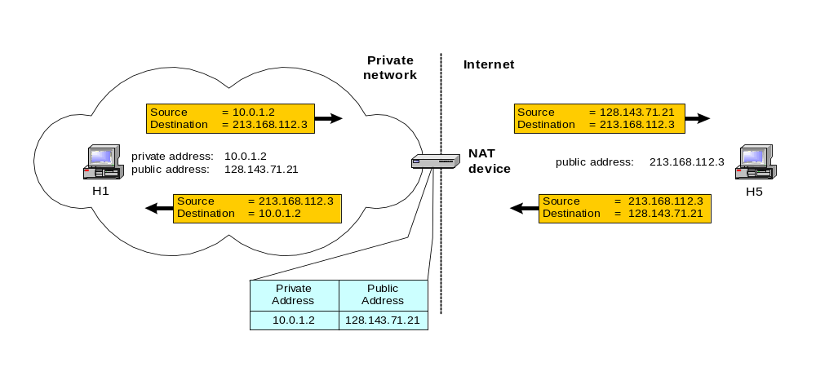
Basic operation of NAT
NAT device has address translation table
Mateti/PacketFilters

Slide 40
Uses of NAT
Pooling of IP addresses
Supporting migration between network service providers
IP masquerading
Load balancing of servers
  iptables -t nat -A PREROUTING -i eth1 -j DNAT --to-destination 10.0.1.2-10.0.1.4
Client-only site (SOHO)
Multiple servers
  Can get into otherwise “hidden” LANs
  Can also load share as NAT round robins connection
Transparent proxying
Mateti/PacketFilters

Slide 41
NAT: Pooling of IP addresses
Scenario: Corporate network has many hosts but only a small number of public IP addresses
NAT solution:
  Corporate network is managed with a private address space
  NAT device, located at the boundary between the corporate network and the public Internet, manages a pool of public IP addresses
  When a host from the corporate network sends an IP datagram to a host in the public Internet, the NAT device dynamically picks a public IP address from the address pool, and binds this address to the private address of the host
Mateti/PacketFilters

Slide 42
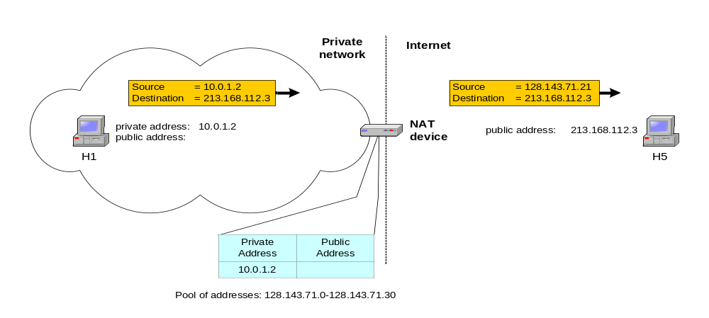
NAT: Pooling of IP addresses
iptables –t nat –A POSTROUTING –s 10.0.1.0/24 –j SNAT --to-source 128.128.71.0–128.143.71.30
Mateti/PacketFilters

Slide 43
NAT: Migration to a new ISP
Scenario: In Classless Inter-Domain Routing (CIDR), the IP addresses in a corporate network are obtained from the service provider. Changing the service provider requires changing all IP addresses in the network.
NAT solution:
  Assign private addresses to the hosts of the corporate network
  NAT device has static address translation entries which bind the private address of a host to the public address.
  Migration to a new network service provider merely requires an update of the NAT device. The migration is not noticeable to the hosts on the network.
Mateti/PacketFilters

Slide 44
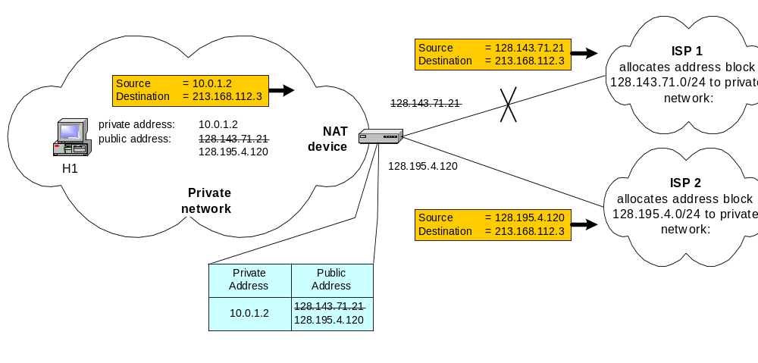
NAT: Migration to new ISP
Mateti/PacketFilters

Slide 45
Concerns about NAT: Performance:
Modifying the IP header by changing the IP address requires that NAT boxes recalculate the IP header checksum
Modifying port number requires that NAT boxes recalculate TCP checksum
Mateti/PacketFilters

Slide 46
Concerns about NAT: Fragmentation
Care must be taken that a datagram that is not fragmented before it reaches the NAT device, is not assigned a different IP address or different port numbers for each of the fragments.
Mateti/PacketFilters

Slide 47
Concerns about NAT: End-to-end connectivity:
NAT destroys universal end-to-end reachability of hosts on the Internet.
A host in the public Internet cannot initiate communication to a host in a private network.
Mateti/PacketFilters

Slide 48
Concerns about NAT: IP address in application data
Applications that carry IP addresses in the payload of the application data generally do not work across a private-public network boundary.
Some NAT devices inspect and adjust the payload of widely used application layer protocols if an IP address is detected.
Mateti/PacketFilters

Slide 49
Source NAT (SNAT)
Mangle the source IP address of a packet
Used for internal → external connections
Done on POSTROUTING, just before packet leaves
Masquerading is a form of this
iptables –t nat –A POSTROUTING –o eth1 –j SNAT –-to-source 10.252.49.231
iptables –t nat –A POSTROUTING –s 10.0.1.2 -j SNAT --to-source 128.143.71.21
Mateti/PacketFilters

Slide 50
Destination NAT (DNAT)
Alters the destination IP address of the packet
Done on OUTPUT or PREROUTING
Load sharing, transparent proxying are forms of this
iptables -t nat -A PREROUTING -i eth0 -p tcp --sport 1024:65535 -d 130.108.17.115 --dport 80 -j DNAT --to-destination 130.108.17.111
iptables -t nat -A PREROUTING -i eth0 -p tcp --sport 1024:65535 -d 130.108.17.111 --dport 80 -j DNAT --to-destination 192.168.17.111:81
iptables -t nat -A PREROUTING -i eth0 -p tcp --sport 1024:65535 -d 130.108.17.111 --dport 80 -j DNAT --to-destination 192.168.56.10-192.168.56.15
Mateti/PacketFilters

Slide 51
IP masquerading
Special case of NAT, Network address and port translation (NAPT), port address translation (PAT).
Scenario: Single public IP address is mapped to multiple hosts in a private network.
NAT solution:
  Assign private addresses to the hosts of the corporate network
  NAT device modifies the port numbers for outgoing traffic
Mateti/PacketFilters

Slide 52
Networking at Home: Masquerading
Modem connections/DHCP
Doesn’t drop connections when address changes
Makes all packets from internal look like they are coming from the modem machine/DHCP address (outgoing interface’s address):
## Masquerade everything out ppp0.
echo 1 > /proc/sys/net/ipv4/ip_forward
modprobe iptable_nat
iptables -t nat -A POSTROUTING -o ppp0 -j MASQUERADE
Mateti/PacketFilters

Slide 53




IP masquerading
Source
= 10.0.1.2
Source
= 128.143.71.21
Source port
= 2001
Source port
= 2100
private address: 10.0.1.2
H1
Private network
NAT
128.143.71.21
Internet
device
private address: 10.0.1.3
H2
Source
= 10.0.1.3
Source
= 128.143.71.21
Source port
= 3020
Source Port
= 4444
Private
Public
Address
Address
10.0.1.2/2001
128.143.71.21/2100
10.0.1.3/3020
128.143.71.21/4444
Mateti/PacketFilters

Slide 54
SNAT vs. MASQUERADE
SNAT
  translates only the source IP addresses, the port number is preserved unchanged.
  requires that you have equal number of outgoing IP addresses as IP address in your intranet
  does not have to search for the available port or available IP address (Hence, SNAT is faster than MASQUERADE)
When you have only a few static IP addresses, MASQUERADE is the preferred method.
Mateti/PacketFilters

Slide 55
IPtable Optimization
Place loopback rules as early as possible.
Place forwarding rules as early as possible.
Use the state and connection-tracking modules to bypass the firewall for established connections.
Combine rules to standard TCP client-server connections into a single rule using port lists.
Place rules for heavy traffic services as early as possible.
Mateti/PacketFilters

Slide 56
State Matching
When tracking connections
NEW – for a new connection
ESTABLISHED – for packets in an existing connection
RELATED – for packets related to an existing connection (ICMP errors, FTP)
INVALID – unrelated to existing connections (should drop)
Mateti/PacketFilters

Slide 57
Stateful Filtering
When router keeps track of “connections”
  Accept TCP packets when connection initiated from inside
  Accept UDP packets when part of response to internal request
Also called dynamic as firewall rules change over time
Mateti/PacketFilters

Slide 58
Stateful Filtering Continued
Increases load on router
Possible DoS point
Router reboots can drop connections
Difficult to know if/when response coming
  Remote machine may be down
  Hole opened in any case
Mateti/PacketFilters

Slide 59
Stateful Filtering Continued
May be able to check for protocol correctness
  E.g., DNS query to DNS port
Logging
  Probably don’t want to log every packet
  Maybe
    First
    Bad
    Attacks
Mateti/PacketFilters

Slide 60
Transparent Proxies
Proxy: software setup on firewall machine
  Each client must know how to connect to proxy
  Proxy then performs connection and relays information
  Only proxy machine needs DNS
  Squid a likely candidate
Mateti/PacketFilters

Slide 61
Transparent Proxies Continued
Another approach: firewall chain intercepts external requests and sends them to proxy
  Clients need not know about proxying
  Clients do need DNS
  Need proxy for each service
Mateti/PacketFilters

Slide 62
Error Codes
If deny (reject), ICMP error message sent back
Helps remote machine stop attempting to connect
  Reduces number of packets
But: may give too much information to attacker
Mateti/PacketFilters

Slide 63
Error Codes Continued
Host and network unreachable
  Problem: some OS’s drop all connections to remote machine if received
  E.g., if connected to web server and attempt to connect to non-existent mail server on same machine, web connection severed
Also: administratively unreachable
Mateti/PacketFilters

Slide 64
References
Oskar Andreasson, “Iptables Tutorial,” 2003, about 150 pages, iptables-tutorial.frozentux.net/
      Comprehensive, but poorly written.
David Coulson, iptables, parts 1 and 2, 2003, about 8 pages, www.davidcoulson.net/writing/lxf/_x000b_38/iptables.pdf ; ... /39/iptables.pdf
      Shallow, but well written
Linux (iptables) http://www.netfilter.org/
FreeBSD (ipfw) http://www.freebsd.org/
OpenBSD (pf) http://www.benzedrine.cx/pf
Mateti/PacketFilters

